Slide 1


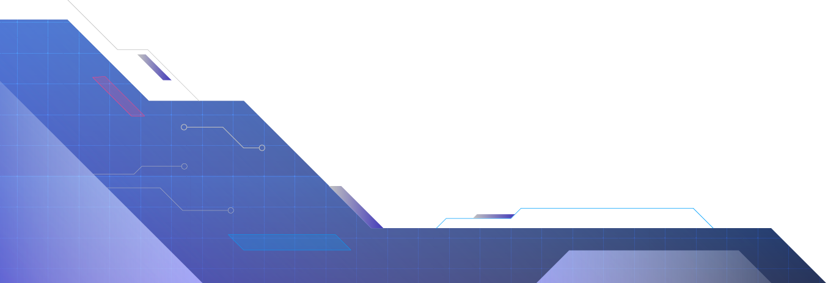
Virtual Robot
simulation
Farah Alwadya

Slide 2
contents
01
02
03
04
Introduction & Problem Statement
System & Robot Design
Algorithms & Simulation
Demo & Conclusion

Slide 3
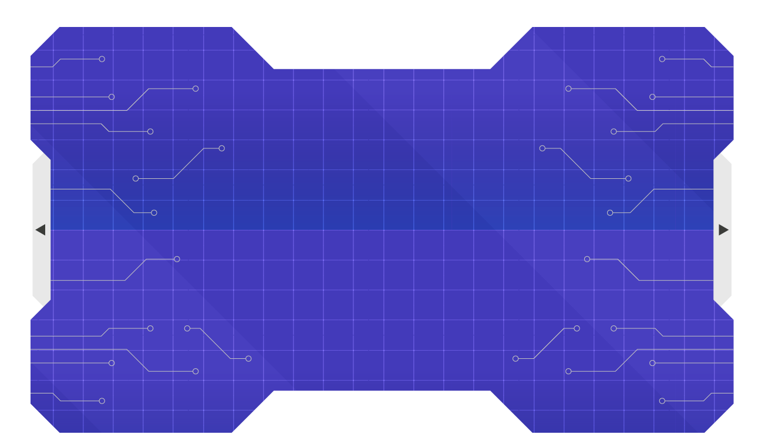
01
Description and problem statment
How to navigate to a goal safely
Avoid obstacles and walls
No external AI libraries used

Slide 4
02
System & Robot Design

Slide 5
System Architecture
Components Overview
Environment
Robot
Simulation
Visualizer
Environment: grid, obstacles, goal
Robot: sensing, decision-making, movement
Simulation: controls execution loop
Visualizer: renders the system

Slide 6
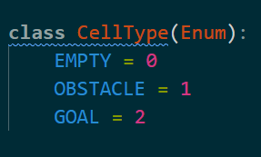
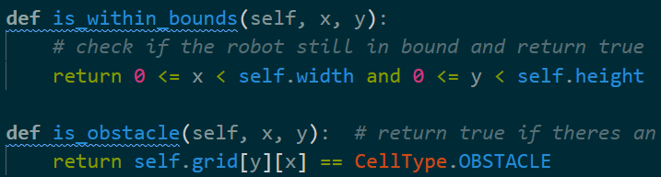
System Architecture
Components Overview
Environment
Robot
Simulation
Visualizer

Slide 7
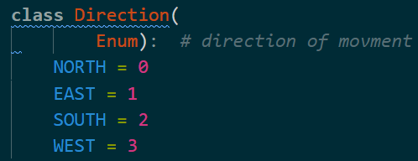
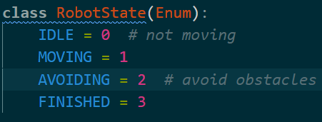
03
Robot Model & environment
Position (x, y)
Direction (NORTH, EAST, SOUTH, WEST)
States: IDLE, MOVING, AVOIDING, FINISHED
Sensors: front sensor, 360 sensor(all direction)

Slide 8
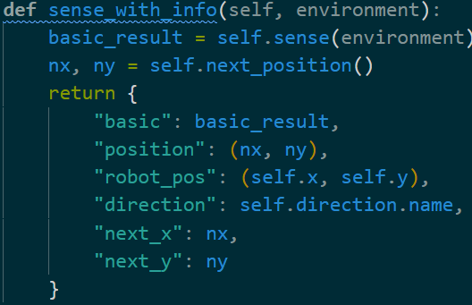
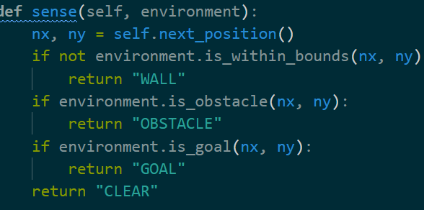
03
Robot Model & environment
Sensors: front sensor, 360 sensor(all direction)
Used for debugging code and test robot behavior

Slide 9
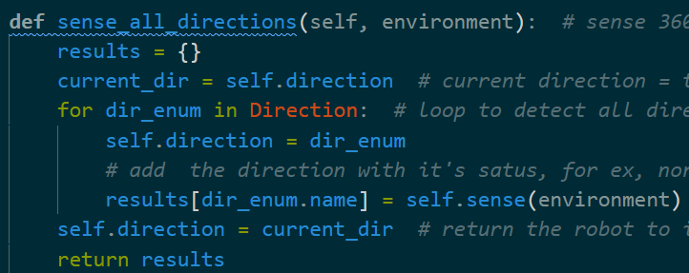
03
Robot Model & environment
Sensors: front sensor, 360 sensor(all direction)
Check all cells around the robot depending on direction

Slide 10
Algorithms & Simulation - Path Planning
BFS Algorithm
Finds shortest path from robot to goal
Recalculates if path blocked or completed
Uses a queue (deque) to explore grid level by level

Slide 11
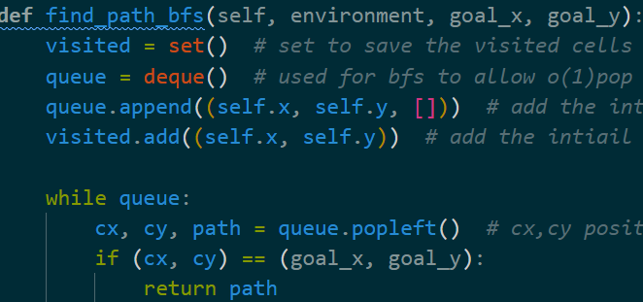
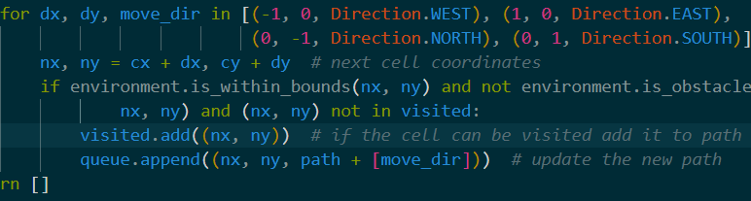
Algorithms & Simulation - Path Planning
BFS Algorithm

Slide 12
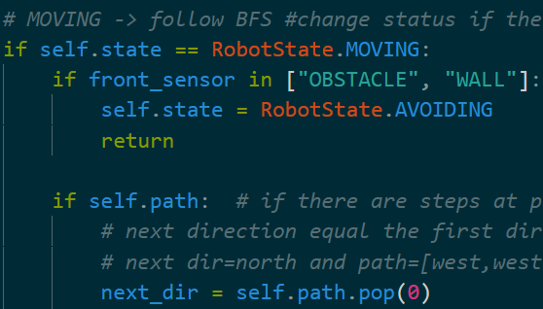
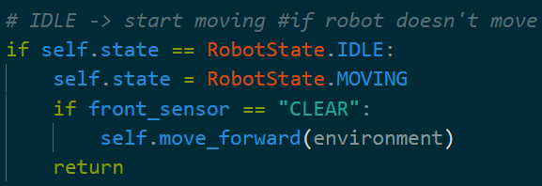
Decision-Making Logic
Finite State Machine (FSM)
IDLE → MOVING → AVOIDING → FINISHED
Transitions based on sensor input or path completion

Slide 13
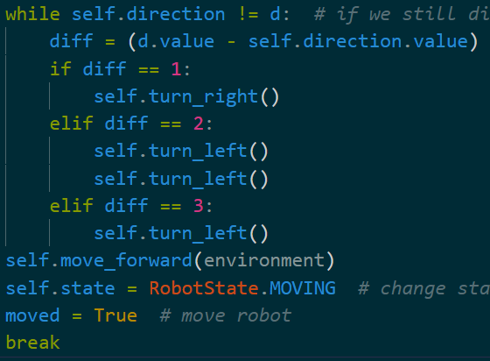
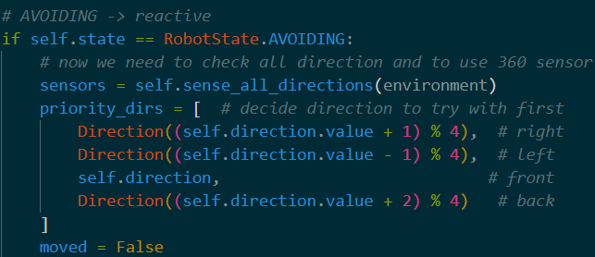
Algorithms & Simulation - Obstacle Avoidance
Reactive Navigation
360degree sensing
Priority: Right → Left → Forward → Backward
Switches to AVOIDING state if blocked

Slide 14
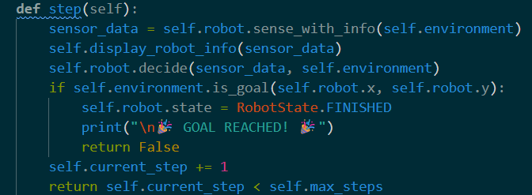
Simulation class
Runs robot step-by-step or continuously
Updates Pygame visualizer
Prints sensor & position info
Checks for goal and stops simulation

Slide 15
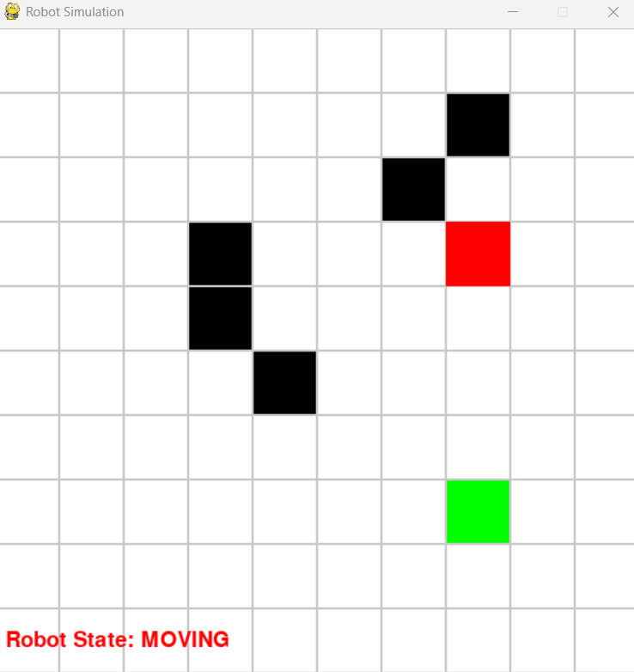
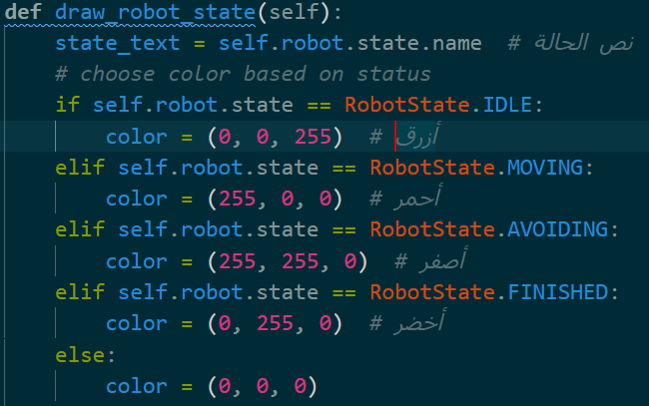
Demo & Conclusion
Demo

Slide 16
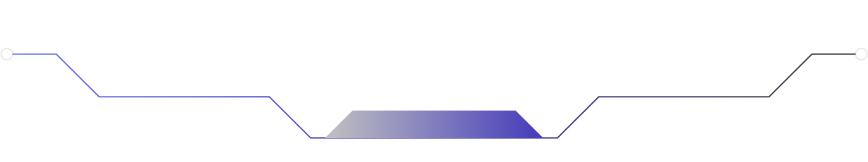
Any question?

